Slide 1
3D Snake game
LIU Qinhan 20328953
LIU Ji 20327997

Slide 2
Presentation Rundown
Motivation
Live Demo
Camera
Lighting
Geometry & Material

Slide 3
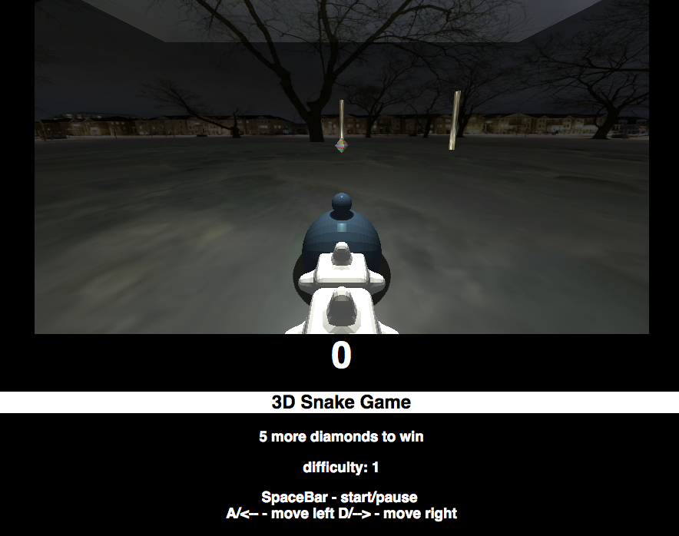
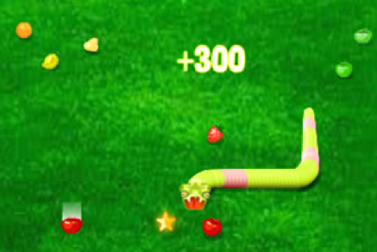
motivation

Slide 4
Live Demo

Slide 6
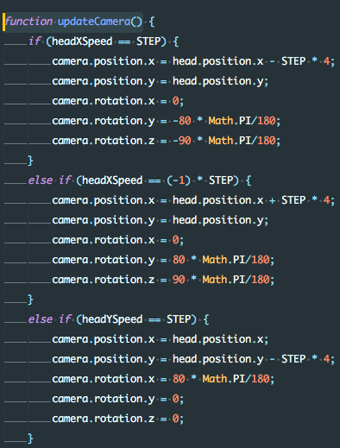
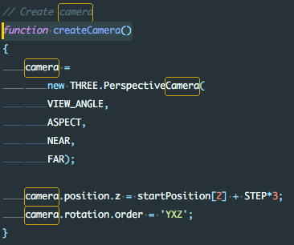
Camera
Camera angle adjusted as the head direction changes
First-person perception

Slide 7
lighting

Slide 8
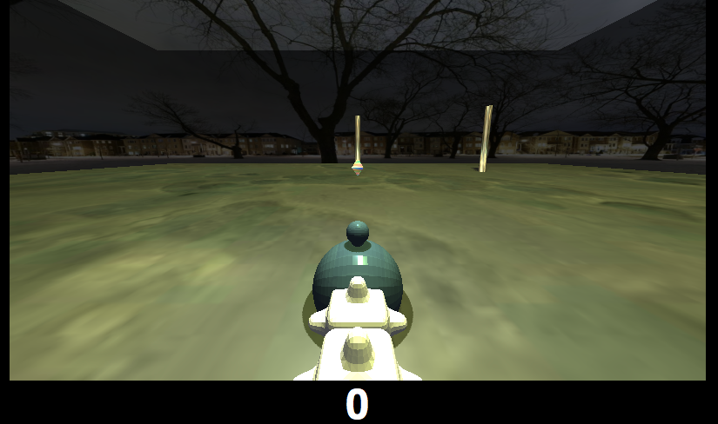
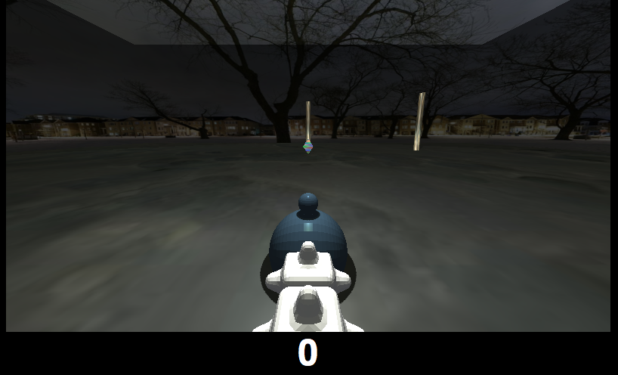
Sun
Day/Night mode of the game
Varies the light condition
Adds shading details to the scene
Better scenery of the game field

Slide 9
ambient light/directional light
Directional light projects to the ground
General surrounding lighting

Slide 10
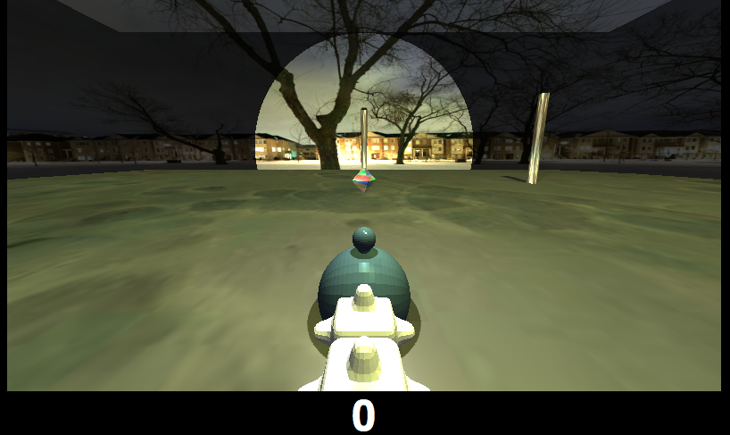
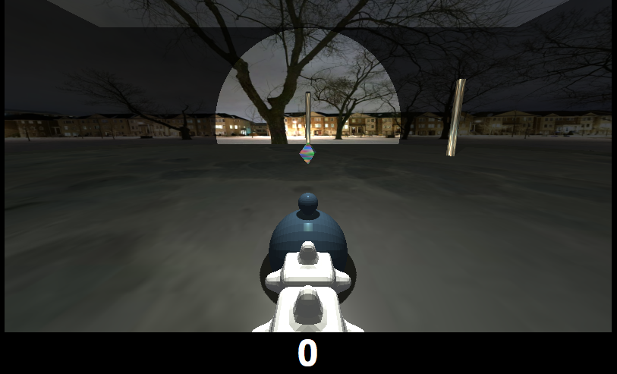
point light
Point light right above the head
Lights up the objects around

Slide 11
Geometry & Material

Slide 12
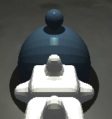
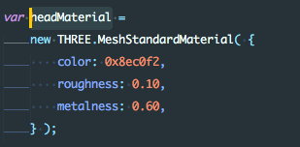
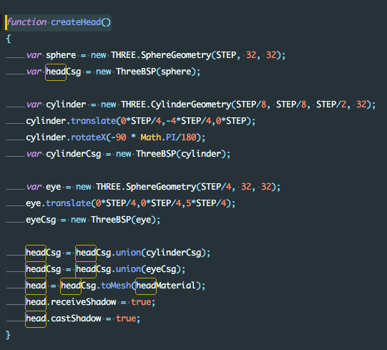
head
Head = two spheres + a cylinder
Convert geometry to CSG format and union them using library

Slide 13
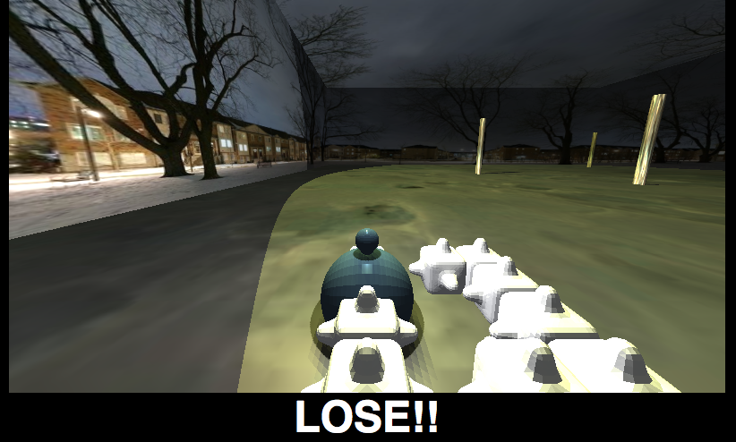
body
Use the cube_bumpy provided in geometry part
Use OBJLoader to load the obj efficiently
Adjust texture to fit the background

Slide 14
planes
Use six planes to wrap the space into a box
Map six concatenated textures onto the planes to create a real and immersive environment

Slide 15
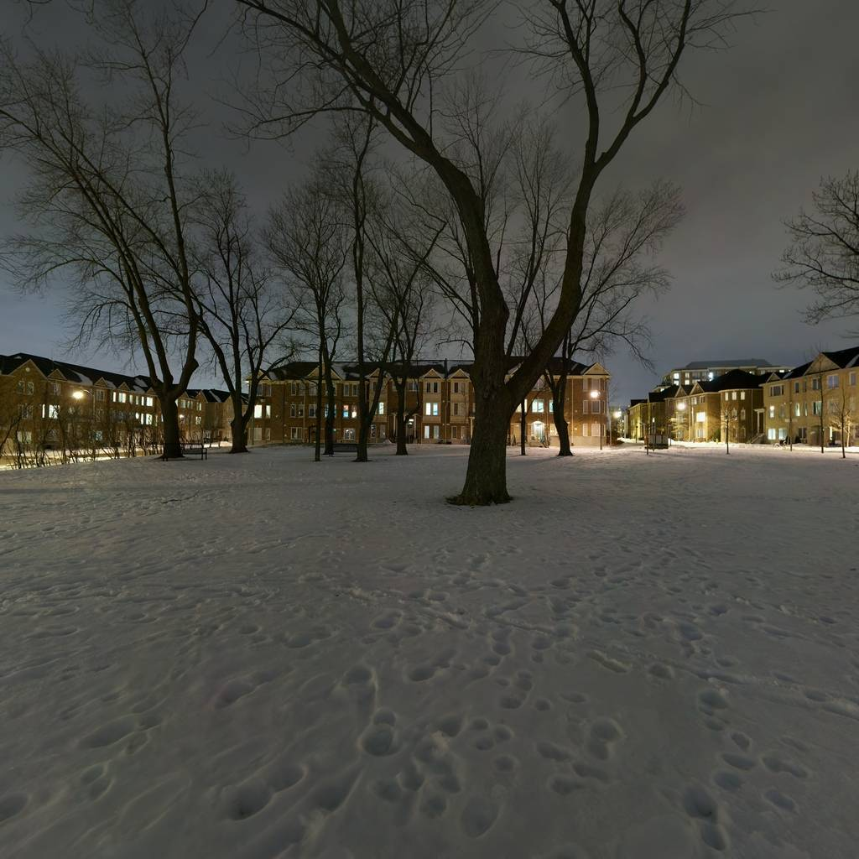
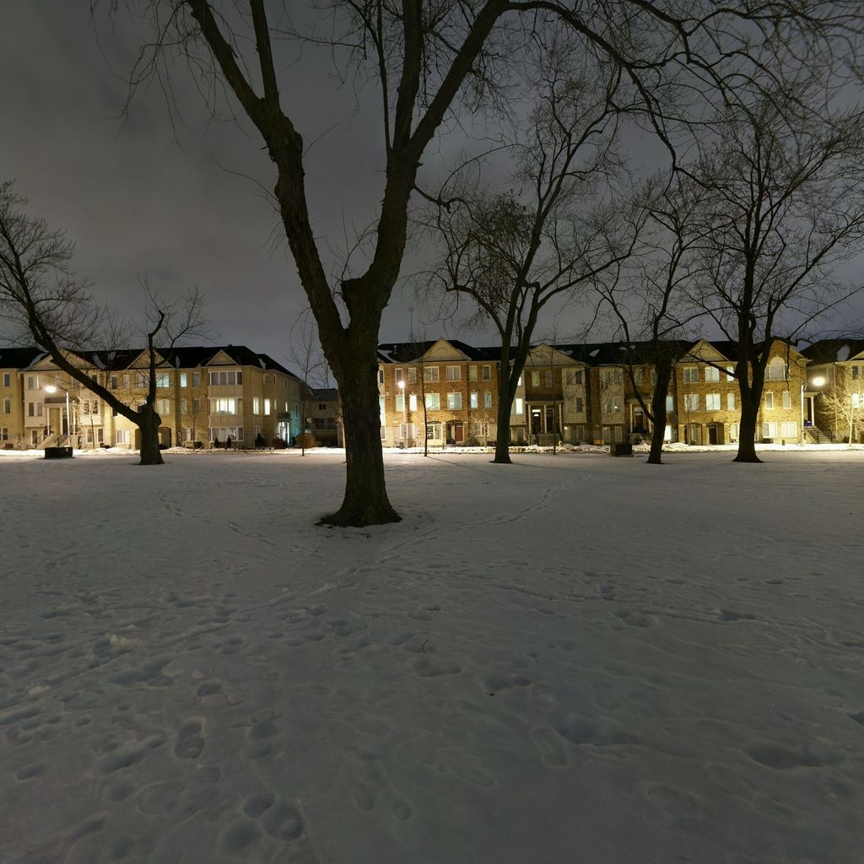

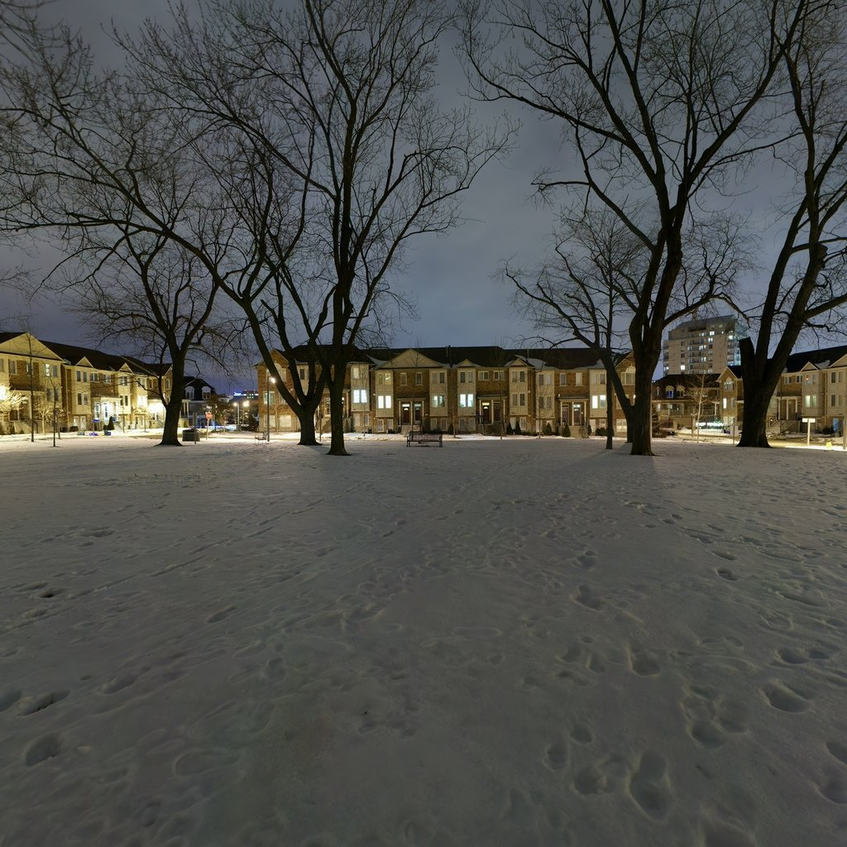
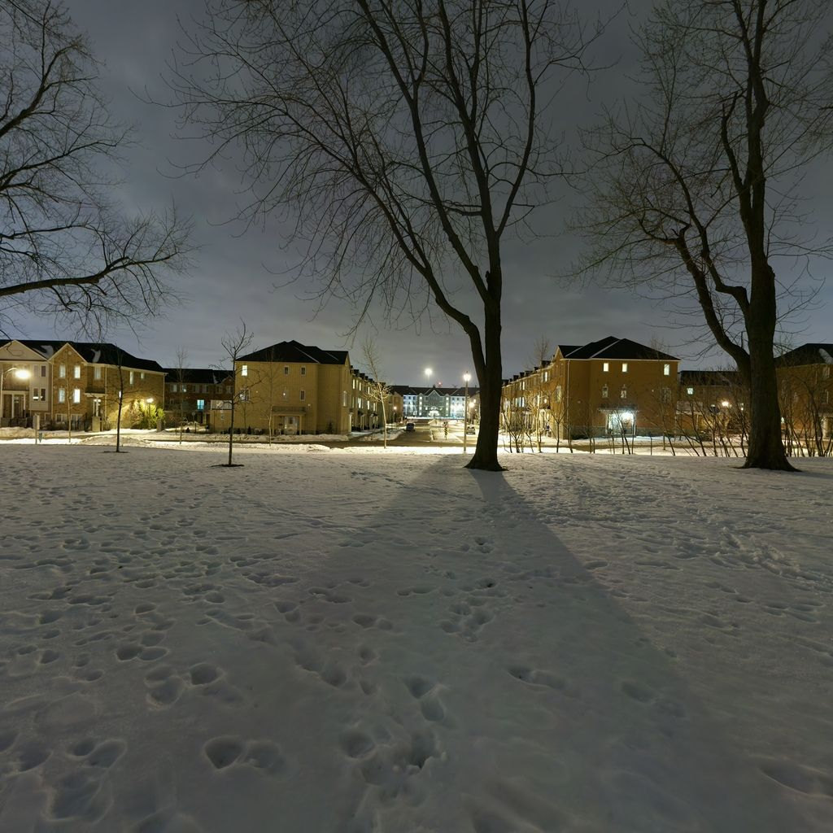
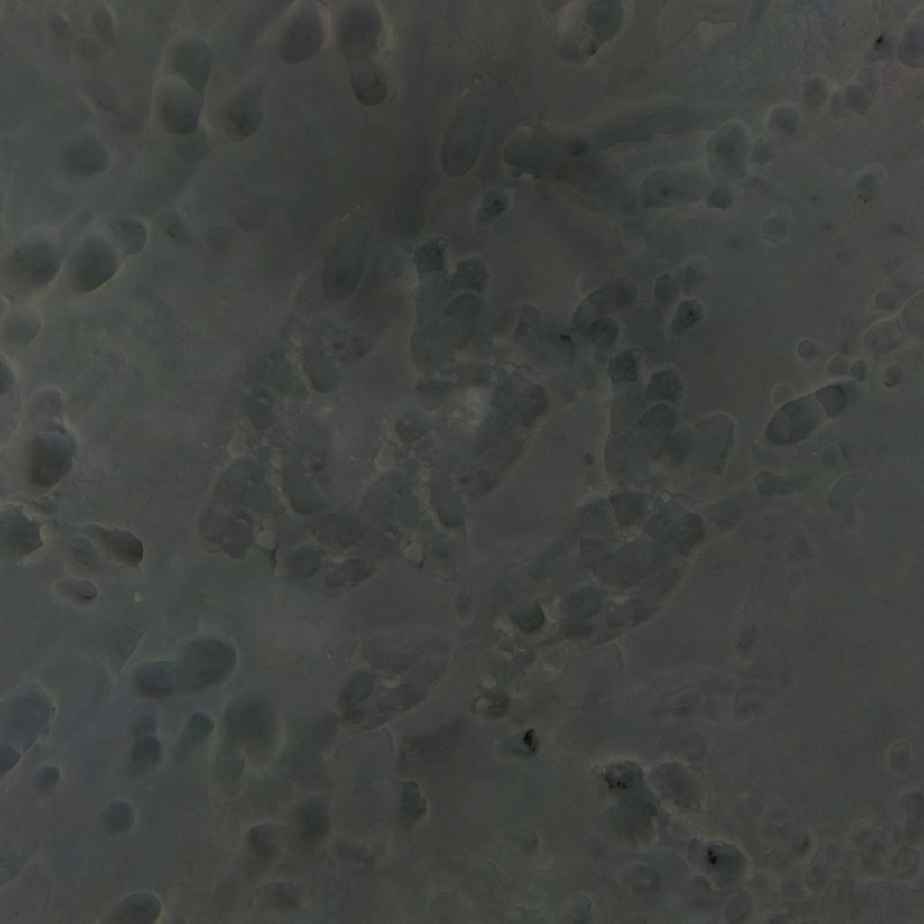

Slide 16
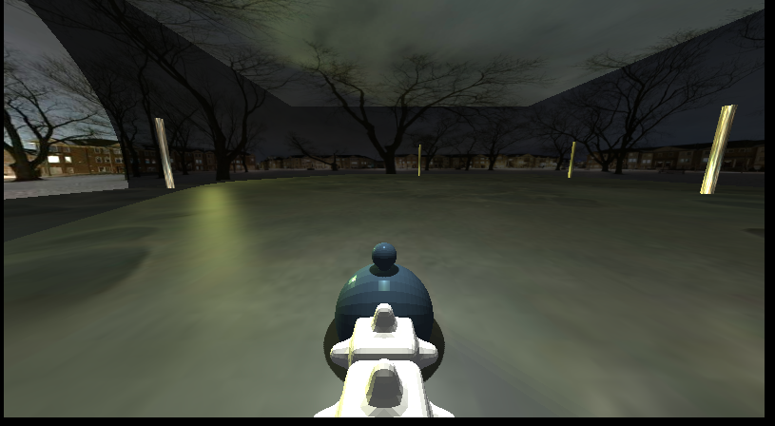

Slide 17
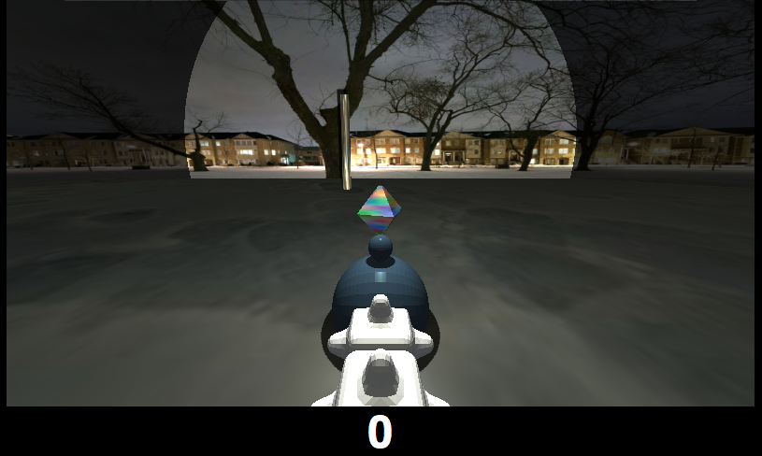
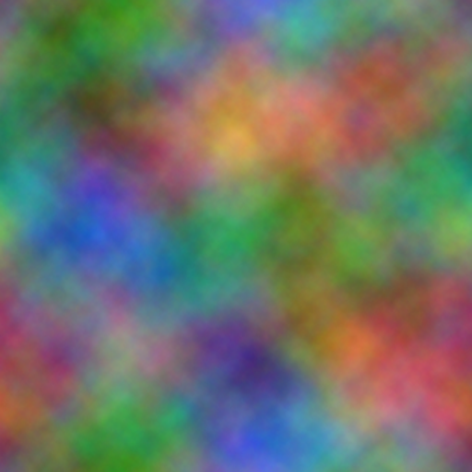
diamond
Create two triangular pyramids from CylinderGeometry
Union to create a diamond-like shape
Wrap a colorful texture
Rotate it to create fancier game experience

Slide 18
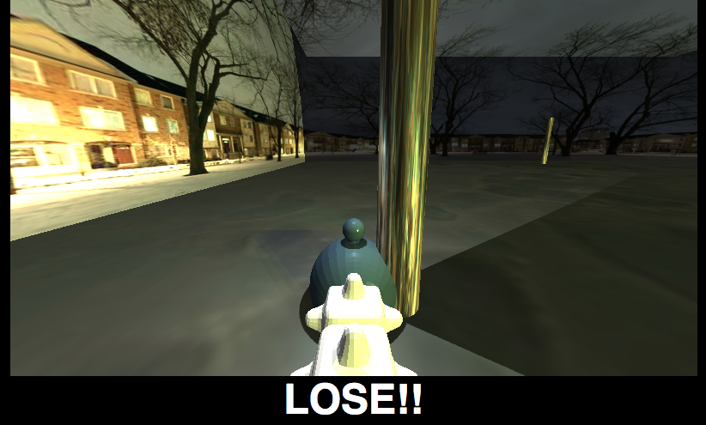
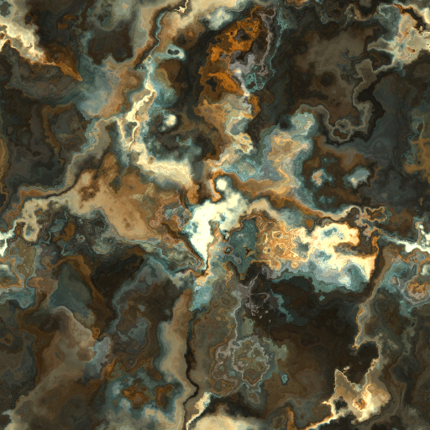
pole (barrier)
Created as a cylinder
Map marble-like texture onto it

Slide 19

3D Snake game
LIU Qinhan 20328953
LIU Ji 20327997
Thank you
A link to our GitHub repository.

